Slide 1
Research Methodology- Unit 4 Measurement, Scaling and Sampling
Prime College- BIM 6th Semester

Slide 2
Research Methodology- Unit 4 Chapter 3- Attitude Rating and Ranking Scales
Prime College- BIM 6th Semester

Slide 3


Learning Outcome
Rating Scale
Ranking Scale

Slide 4
Rating Scale
Rating scales have several response categories and elicit responses about the object, event, behavior, attitude, or person studied.
Some important rating scales are described below:
Dichotomous scale
Category Scale
Likert scale
Semantic differential scale
Numerical scale
Itemized rating scale
Fixed or constant sum scale
Stapel scale
Graphic rating scale

Slide 5
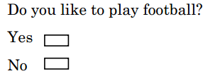
Rating Scale
Dichotomous scale
Elicit yes or no answers.
Represents the nominal level of measurement.
It gives two extreme responses.

Slide 6
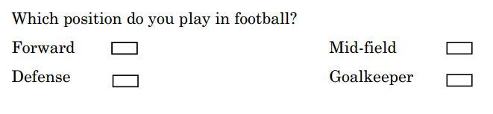
Rating Scale
2. Category Scale
It uses multiple items to elicit a single response.
Under this scale, respondents should choose any one alternative out of many.

Slide 7

Rating Scale
3. Likert scale
The Likert scale is designed to examine the attitude of respondents regarding certain phenomena by checking how strongly he or she agree or disagree with the statement proposed in the questionnaire.
It is an interval level of measurement in which the differences in response between any two points on the scale remain the same.

Slide 8
Rating Scale
4. Semantic differential scale
Semantic differential scales or S.D. scale was developed by Charles E. Osgood, G.J. Suchi, and P.H. Tannenbaum in 1957 to measure an object's psychological meaning to an individual.
This scale is based on the presumption that an object can have different dimensions of connotative meanings, which can be located in multidimensional property space or what can be called semantic space.
This scaling consists of a set of bipolar rating scales, usually of 7 points, by which one or more respondents rate one or more concepts on each scale item. For instance, the S.D. scale items for analyzing candidates for leadership positions may be shown as follows (Kothari, 2009, p.90)

Slide 9
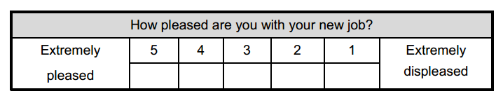
Rating Scale
5. Numerical scale
The numerical scale is somewhat similar to the semantic differential scales, but the only difference is that numbers on a 5-point or 7-point scale are provided.

Slide 10
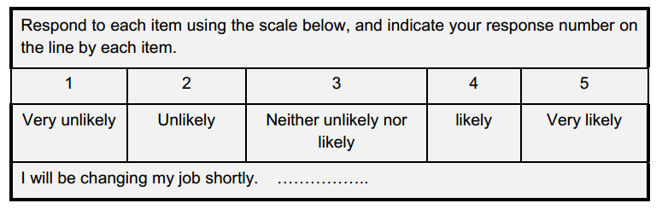
Rating Scale
6. Itemized rating scale
In itemized rating scales, the rater must select one of the limited number of categories ordered regarding their scale position.
Like in the numerical scale, a five or seven-point scale is provided for each item, and the respondent states the appropriate number on the side of each item.

Slide 11
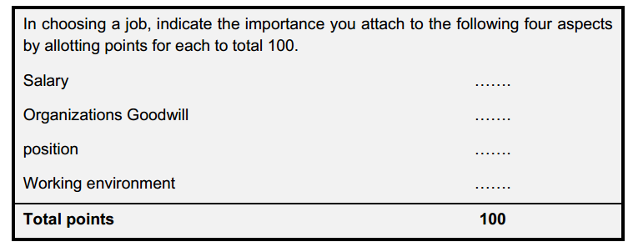
Rating Scale
7. Fixed or constant sum:
In a fixed or constant sum scale, the respondents are asked to distribute several points across various items

Slide 12
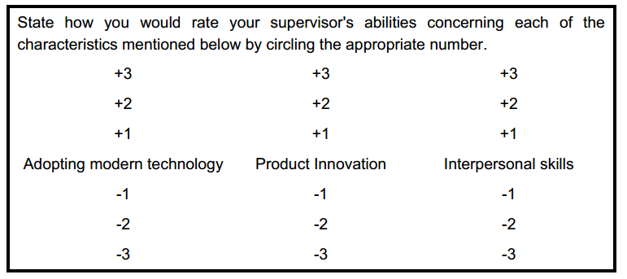
Rating Scale
8. Stapel scale:
The Stapel scale is a somewhat modified version of the semantic differential scale.
This scaling method measures the attitude's direction and intensity simultaneously.
It measures how close to or distant from the adjective a given stimulus is perceived to be.
The characteristic of interest to the study is placed at the center, and a numerical scale ranging from +3 to -3 on either side of the item as an illustration.

Slide 13
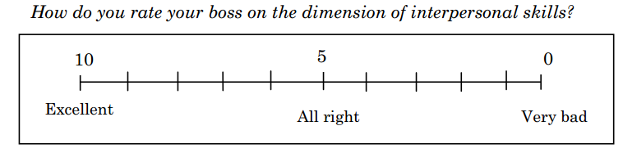
Rating Scale
9. Graphic rating scale:
The rating takes place in graphical form; otherwise, it is similar to the itemized rating scale.
A graphical representation helps the respondents indicate their answers to a particular question on this scale by placing a mark at the appropriate point on the line.

Slide 14
Techniques for Developing Attitude Scales
Ranking scales tap or order preferences between two or among many objects or items. The ranking scale represents the ordinal level of measurement.
Some valuable methods of ranking scales are given below:
Rank order scales
Pair comparison scale

Slide 15
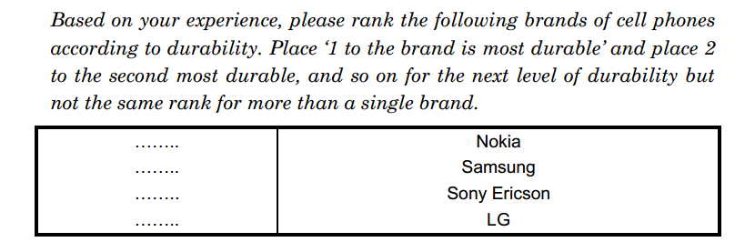
Ranking Scale
1. Rank order scales
In rank order scales, respondents are asked to rank all the items according to some criteria.
Rank order scales have three convenient analytic advantages (Kerlinger, 1973, p.505).
The scales of individuals can easily be inter-correlated and analyzed.
Composite rank orders of groups of individuals can also easily be correlated.
Scale values of a set of stimuli can be calculated using one of the rank-order scaling methods.
They partially escape the response set and the tendency to agree with socially desirable items.

Slide 16
Ranking Scale
Pair comparison scale:
This is a comparative scaling technique in which respondents are provided two alternatives for each object.
They are asked to select one object (rate between two objects at a time) according to some criterion from given two objects.
Data obtained from the paired comparison method are ordinal.

Slide 17
End of Chapter 3
(Click the arrow when in Slide Show mode)
Notes:
In Slide Show mode, click the arrow to enter the PowerPoint Getting Started Center.

